Slide 1
Project 2
Group Members:
Tim Tang
Fred Tinio
Kevin Ewing
Laura De Morneau

Slide 2
Extract Process
Read data
We used several API processes to cleanse and prep files in the following formats:
CSV files
JSON files
Spreadsheets
HTML tables

Slide 3
Transformation Process
Data cleaning
Summarization
Selection
Joining
Filtering
Aggregating

Slide 4
Load Process
The final load process consolidated multiple data sources into one database to be used for:
Data Scientists analysis and queries
Automated Dashboard Reporting

Slide 5





Project 2 – ETL Process Flowchart
Data Acquisition
Data Integration
Data Repository
Presentation &
Visualization Layer
External Sources
Insights and Management Tools
External & Legacy Information Sources
Brand
JSON
Jupyter Notebook
MySQL / Pandas
Marketing
CDC Zike Data .csv
Touch Point
Touch Point Person
Census Data 2 .csv
Database 1
Automation / Reporting and Analytical Tools
Field Marketer
Reports
USPS NCOA
Consumer
Census Data .csv
Response Data
Device Data
Leads Agents
Common End to End Audit and Validations

Slide 6
Project 2 – ETL Process Flowchart
Data Acquisition
Data Integration
Data Repository
Presentation &
Visualization Layer
External Sources
Insights and Management Tools
External & Legacy Information Sources
Brand
JSON
Jupyter Notebook
MySQL / Pandas
Marketing
CDC Zike Data .csv
Database 1
Touch Point
Touch Point Person
Census Data 2 .csv
Automation / Reporting and Analytical Tools
Field Marketer
Reports
USPS NCOA
Consumer
Database 2
Census Data .csv
Response Data
Device Data
Leads Agents
Common End to End Audit and Validations

Slide 7
Conclusion
This entire ETL process was done to simplify day to day activities into one central repository for Data Scientists and Analysts to query data in one central location.
Each E-T-L step was tested and validated to ensure data integrity and accuracy.
Data extraction and updates is scheduled daily at 11:59pm EST

Slide 9
Appendix

Slide 10
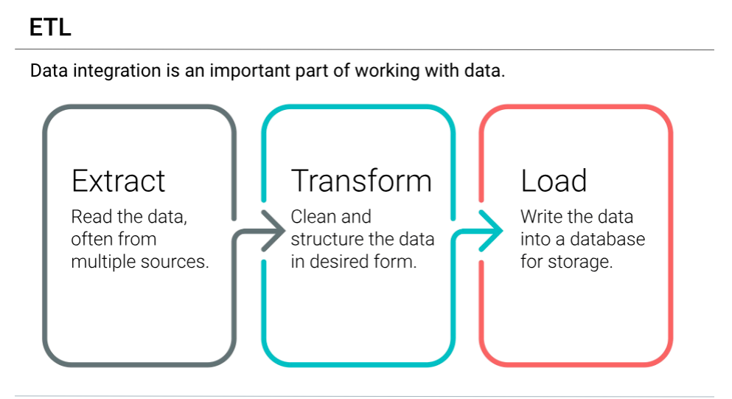

Slide 11
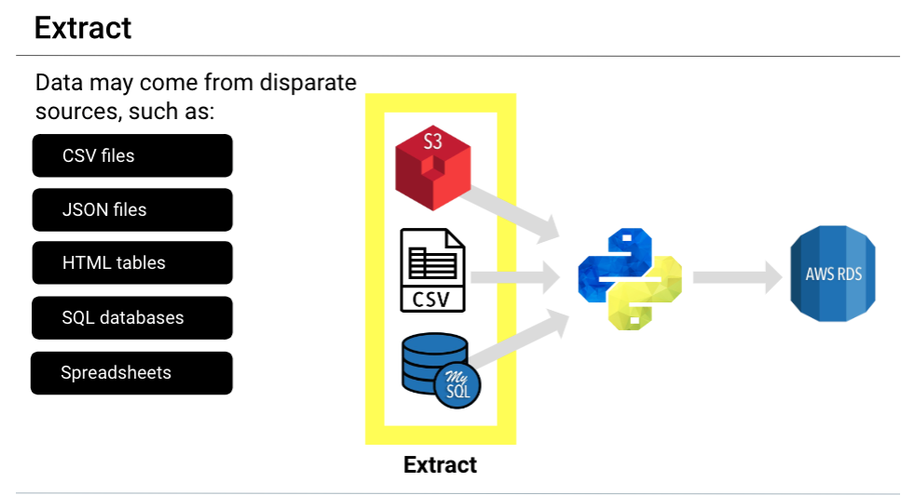

Slide 12
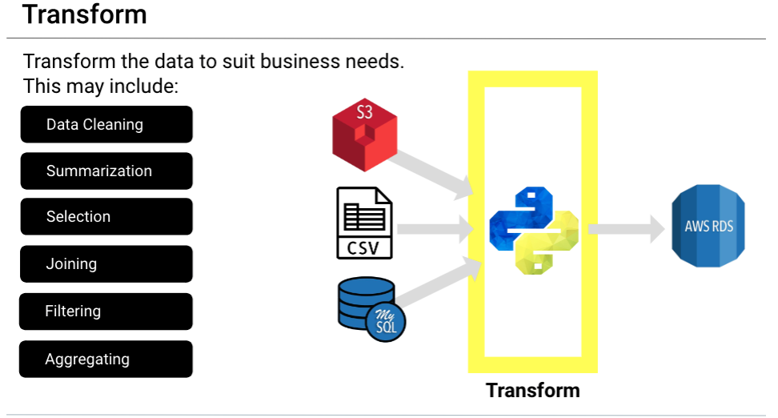

Slide 13
